Slide 1
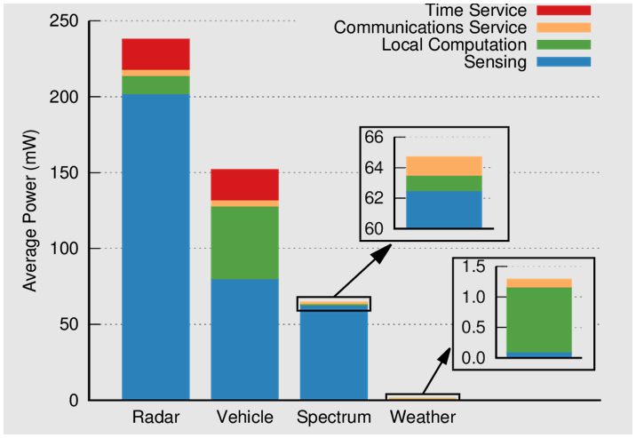
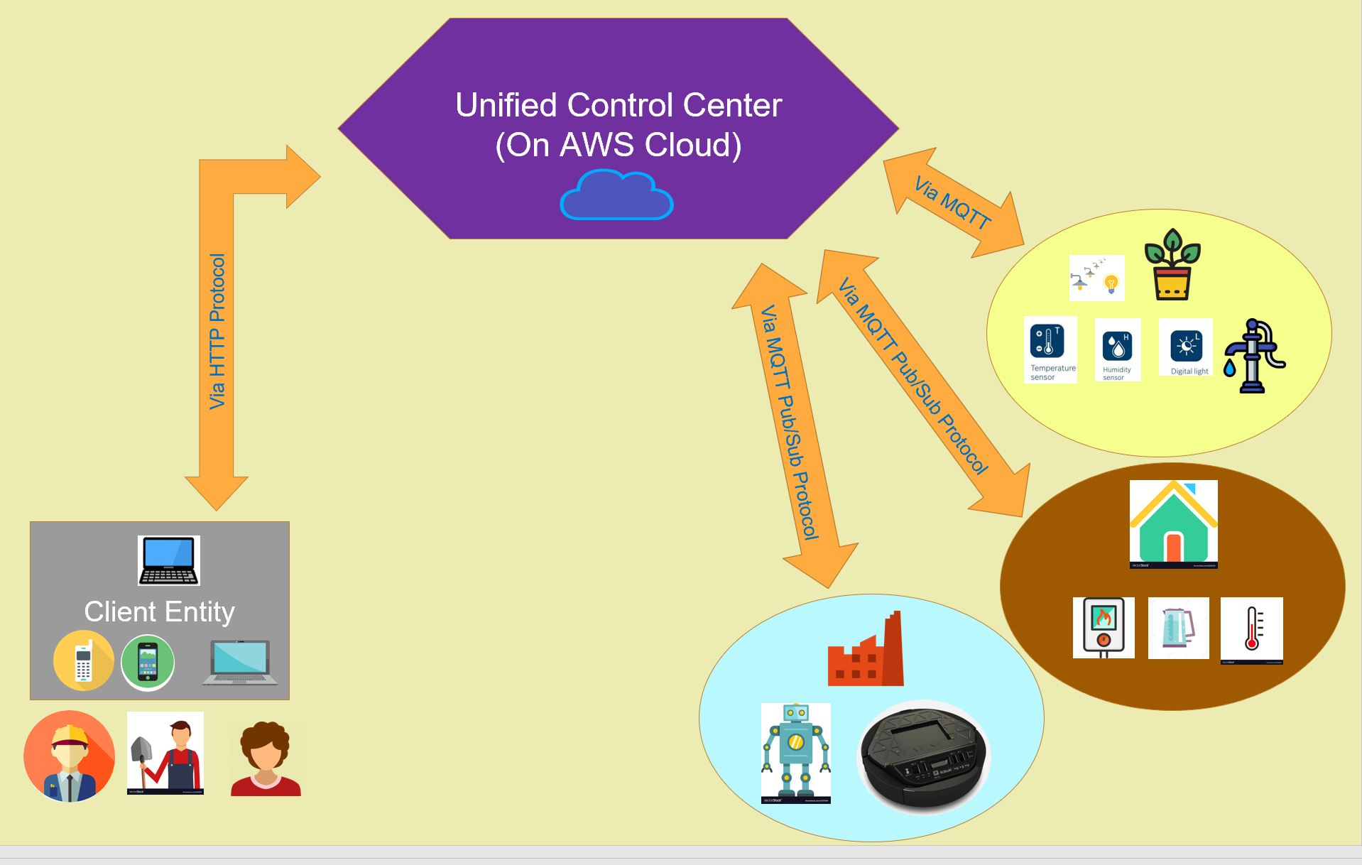
GRASP: Generalizable, Remote, Actuation & Sensing of a Process
Tanner DeKock, Lam Lenguyen, Aditya Tyagi, David Vakshylak
Heading
To create a system that allows for remote sensing, actuation, and control of processes that is generalizable across application areas.
Depth Application: Smart Gardening
Explanation paragraph. Enough to explain what’s going on, but not so much text that it goes on and on. Much better to get to the point and let the pictures do most of the talking.
Breadth Applications: Smart Home & Industry 4.0
Explanation paragraph. Enough to explain what’s going on, but not so much text that it goes on and on. Much better to get to the point and let the pictures do most of the talking.
Explanation of the figure. Point out important features that the figure demonstrates.
Explanation of the figure. Point out important features that the figure demonstrates.
General Schema:
The Unified Control Center acts as a liason between the client entity and application level devices, facilitating data flow and control command flow.
Some sections have multiple figures in them. Explanation paragraph. Enough to explain what’s going on, but not so much text that it goes on and on. Much better to get to the point and let the pictures do most of the talking.
Explanation of the figure. Point out important features that the figure demonstrates.
Course Topics:
Sensing & Actuation
Feedback Control
Networking
Input & Output
Cybersecurity?
Explanation of the figure. Point out important features that the figure demonstrates.
Explanation of the figure. Point out important features that the figure demonstrates.
Explanation of the figure. Point out important features that the figure demonstrates.

Slide 2


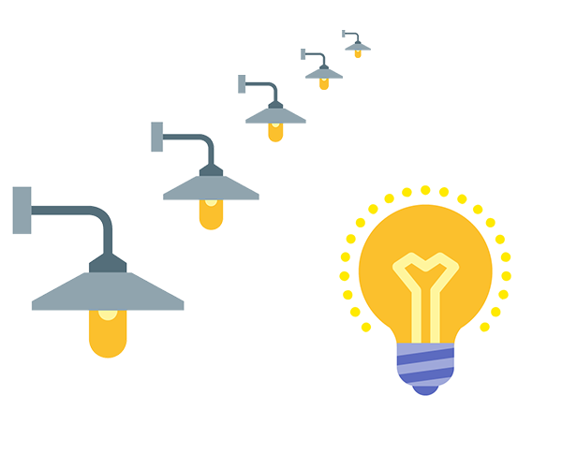
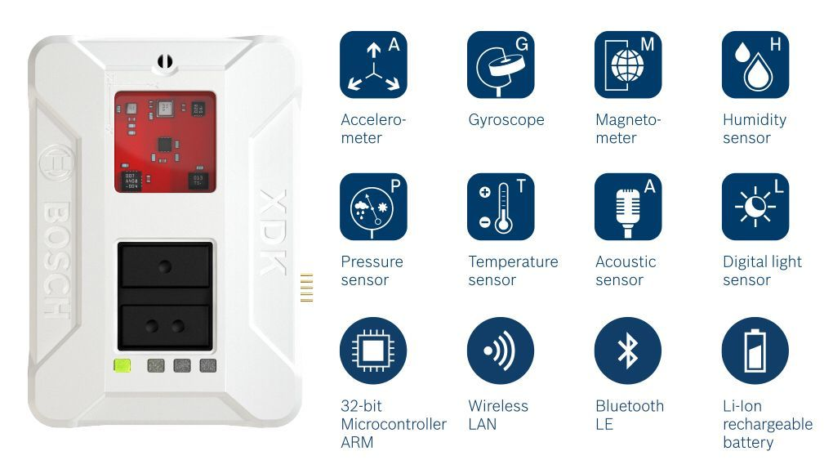
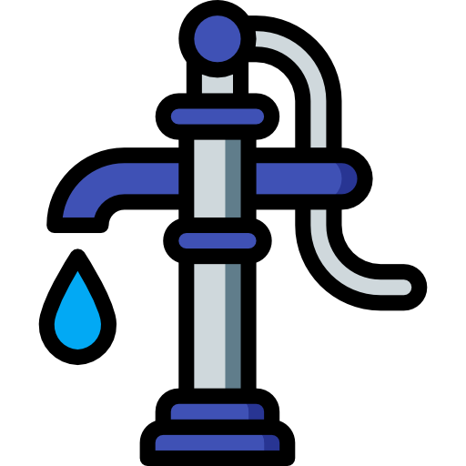

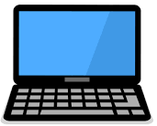

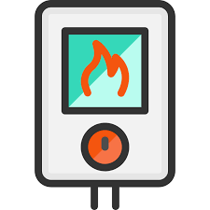

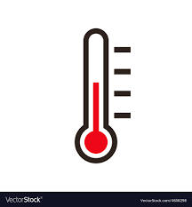






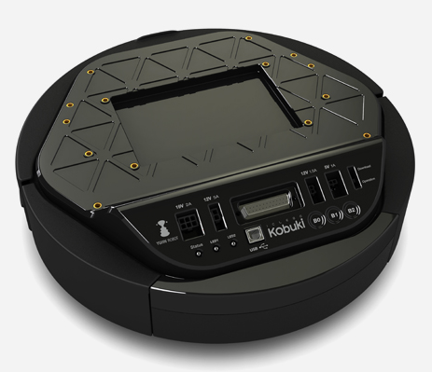

Unified Control Center (On AWS Cloud)
Via MQTT
Via HTTP Protocol
Via MQTT Pub/Sub Protocol
Via MQTT Pub/Sub Protocol
Client Entity

